Slide 1
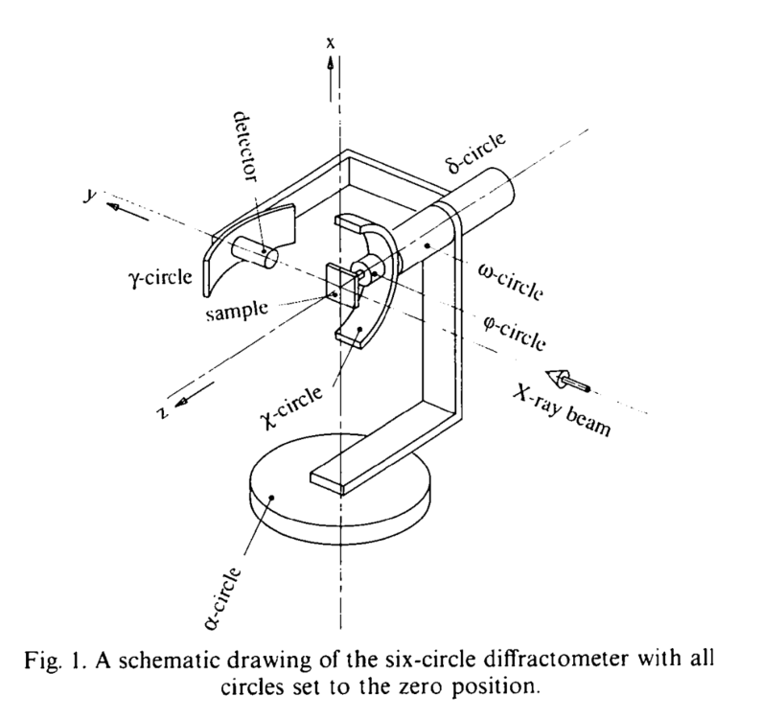


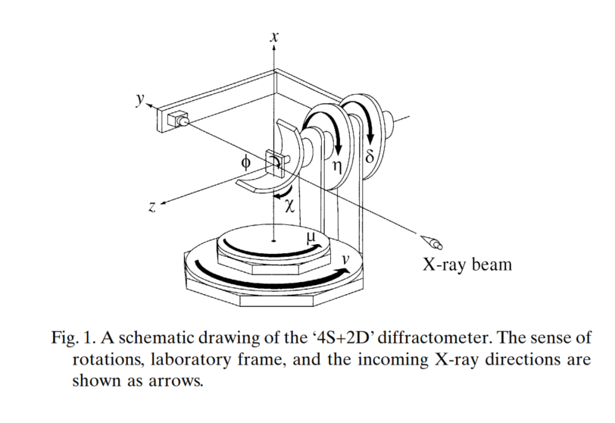
paper: Lohmeier & Vlieg IUCr 6-circle, SPEC :sixc, Hkl: APS POLAR rotated?
paper: H. You SPEC psic, Huber 6-circle, Hkl: E6C

